Slide 1

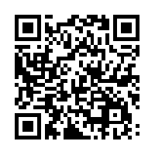
MATLAB Fundamentals
Tutoring Session by GESSA
Register at : http://goo.gl/pM7Btx
Date: Friday, September 4th
Time: 4:00pm to 6:00pm
Location: BYAC 110
Contact: Rajat Aggarwal (480 519 5668)
Vignesh Natarajan (425-326-0153)

